Slide 1

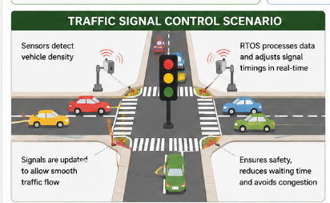
Real-Time Embedded System Used in Traffic Signal Control
Name : Sruthi Rithika P
Reg.no :192521407

Slide 2
Introduction
Embedded System: Dedicated computing unit built for specific control tasks within a larger device.
Real‑Time Operating System (RTOS): OS that guarantees timing constraints and deterministic behavior.
Traffic signals require strict timing guarantees for safety and coordination.
Objectives: explain architecture, RTOS selection, system calls, timing, and working example.

Slide 3
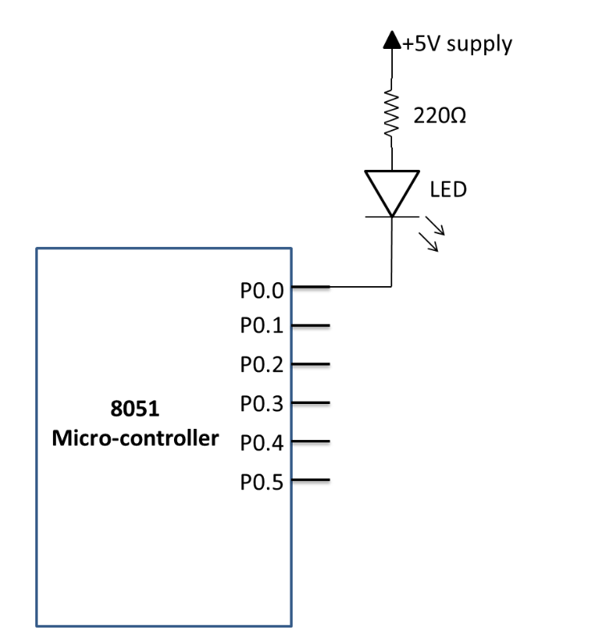
Traffic Signal Embedded System — Architecture & Components
Microcontroller / Processor:Acts as the brain of the system and controls signal operations
Traffic Lights:Display red, yellow, and green signals.
Vehicle Sensors:Detect vehicles and help manage traffic flow.
Pedestrian Push Button: human input & safety interlocks.
Timer & Communication Module: time base and networked coordination (e.g., RS485, Ethernet).

Slide 4
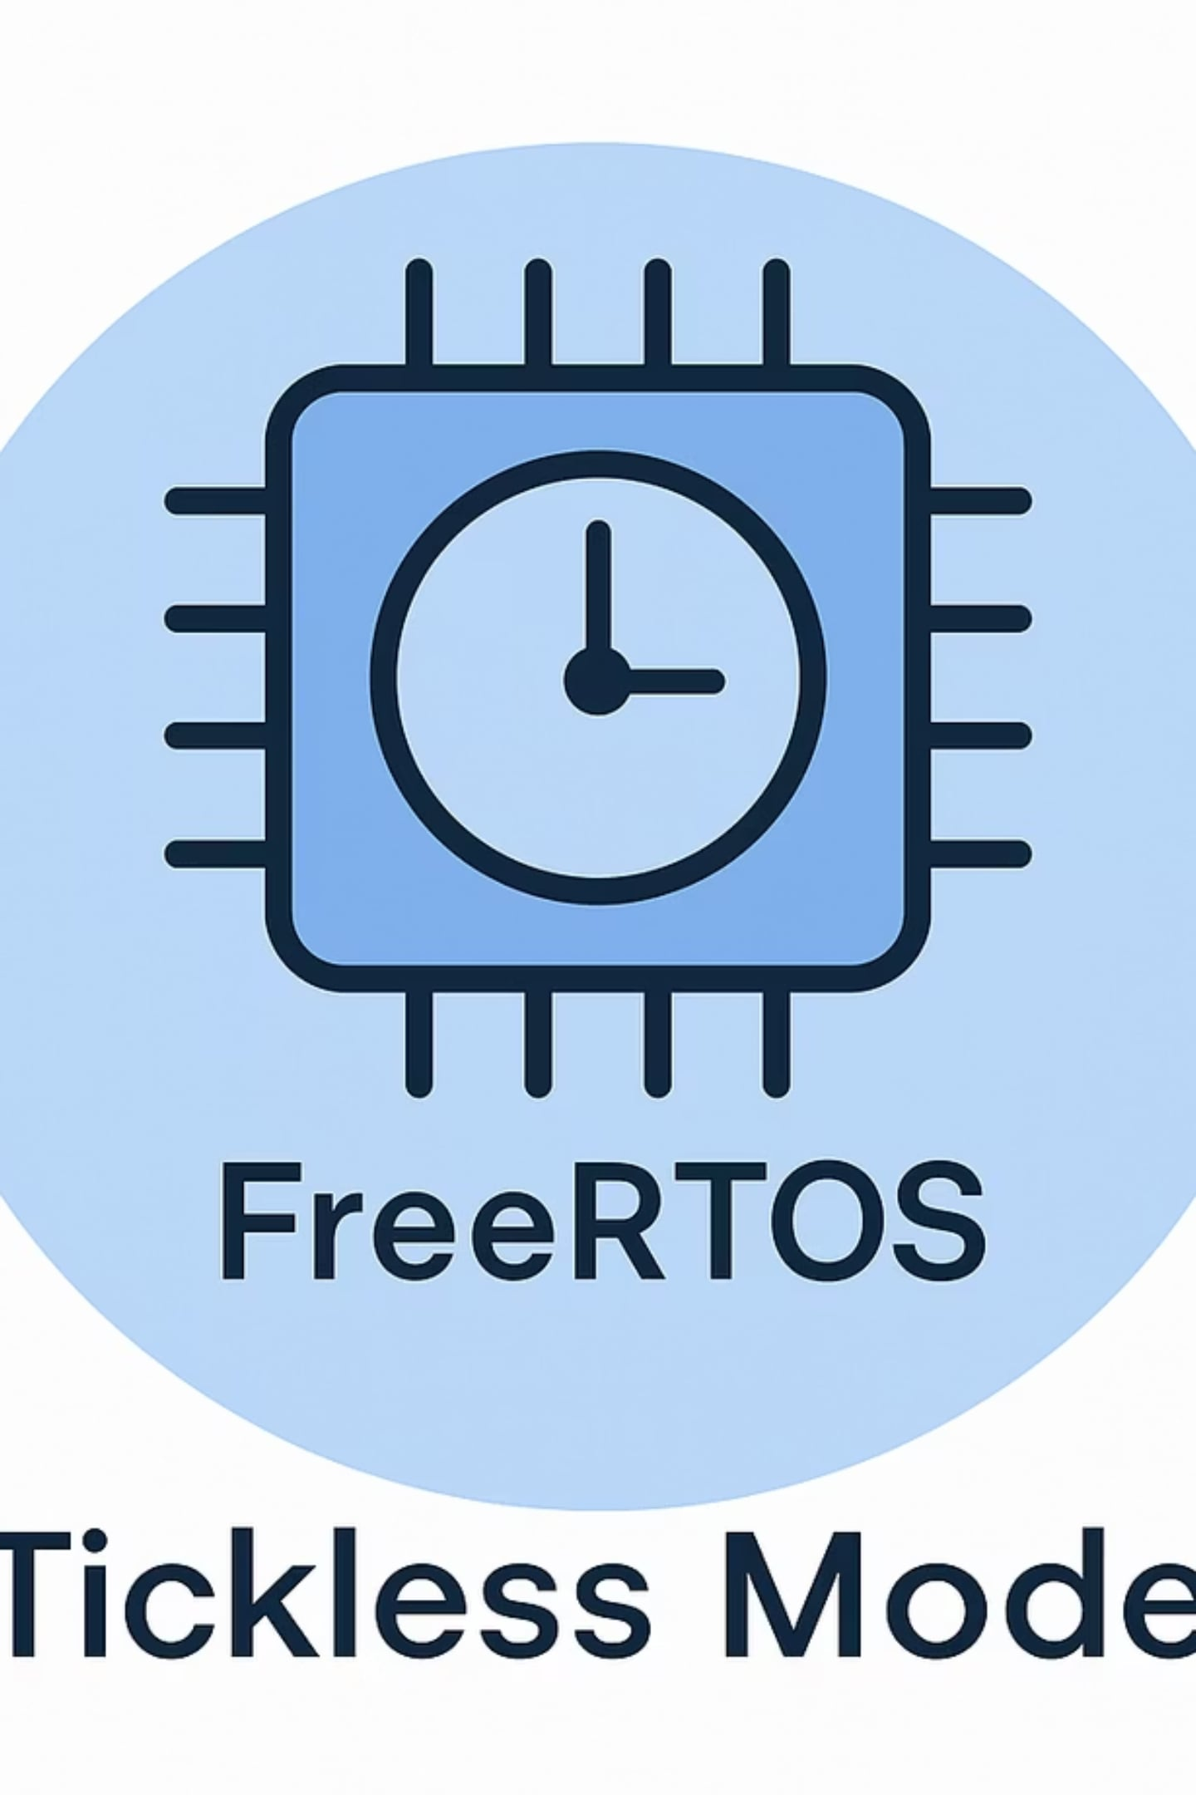
Type of Operating System Used — RTOS & Justification
Use: Real‑Time Operating System (RTOS) for deterministic timing.
Hard RTOS vs Soft RTOS: Hard enforces deadlines (miss = failure); Soft tolerates occasional misses.
Traffic signals: Hard real‑time requirements for safety-critical deadlines.
Common RTOS examples: FreeRTOS, VxWorks, QNX, RTLinux.

Slide 5
Key Advantages
Deterministic response: guaranteed worst‑case response time.
Predictable timing & low latency—critical for phase switching.
Fast interrupt handling & prioritized scheduling.
High reliability and resource control for 24/7 operation.
Supports modular drivers and network coordination.
Normal OS
RTOS
Best‑effort scheduling
Priority-based deterministic scheduling
Variable latency
Bounded worst‑case latency
General-purpose drivers
Real‑time drivers & ISRs
Less suitable for safety deadlines
Designed for hard deadlines

Slide 6
RTOS Structure & Core Components
Application Tasks: Control traffic lights, sensors, and communication.
Scheduler:: Decides which task runs based on priority.
Kernel:Handles task switching, timing, and communication..
Device Drivers & ISRs: sensor input and light actuator drivers with fast ISR paths.
Memory & Timer Management: deterministic allocation and hardware timer services.

Slide 7
System Calls for Process Control (Traffic Context)
TaskCreate / TaskDelete: To create tasks or remove diagnostics tasks.
TaskSuspend / TaskResume: temporarily pause pedestrian or sensor tasks during overrides.
Semaphore / Mutex: protect shared resources (lamp driver, configuration data).
Message Queue / Event Flags: pass sensor events and timing commands between ISRs and tasks.
Example: ISR posts event → MessageQueueSend → PhaseControllerTask wakes and changes signal.

Slide 8
System Calls for Timing (Traffic Context)
Delay(ms) / Sleep(): short non-blocking waits for task pacing.
TimerStart() / TimerStop(): hardware timers to schedule phase durations.
Clock Tick & Periodic Scheduling: tick-driven scheduler for periodic checks and soft timeouts.
Interrupt Handling: capture sensor pulses and generate immediate events.
Relation: Timer triggers phase end → Scheduler switches to next light with bounded latency.

Slide 9
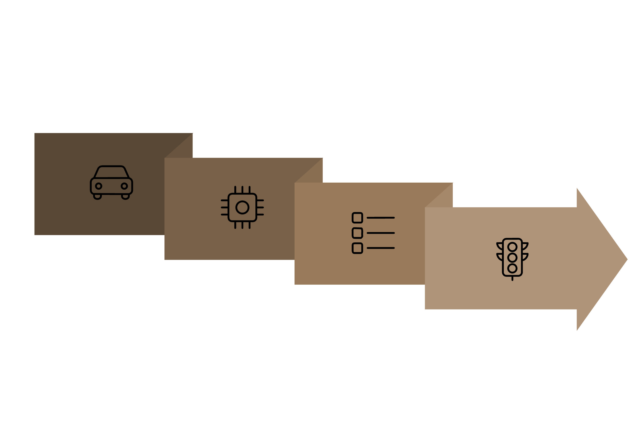
Working Example — Complete Flow
ISR & Queue
Phase: Green→Yellow→Red
Sensor detects vehicle → ISR quickly timestamps and queues event.
Scheduler prioritizes PhaseTask →The task reads the sensor data and starts the timer for the traffic signal.
PhaseTask commands actuator to Green → when timer expires transitions to Yellow, then Red.
Pedestrian crossing:If a pedestrian presses the crossing button, EventFlags notify the system.
Detect Vehicle
Scheduler → PhaseTask

Slide 10
Conclusion & Future Scope
RTOS ensures deterministic, reliable traffic signal control with bounded latency.
Supports multitasking, prioritized interrupts, and safe driver abstractions.
Benefits: improved safety, reduced congestion, maintainability.
Future: integrate AI, IoT communication, adaptive phase timing, and cloud analytics.

